Slide 1
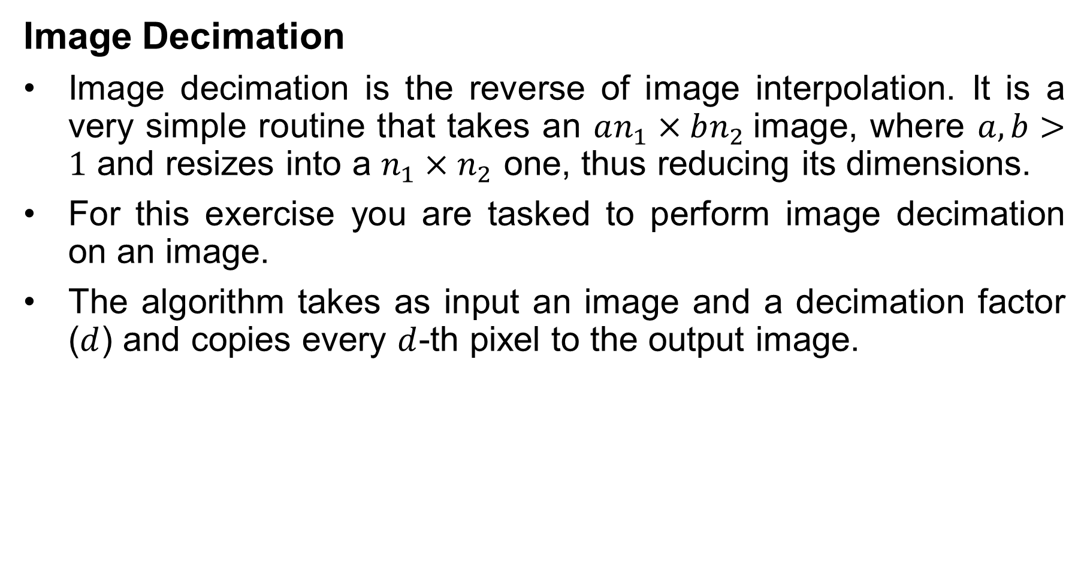
Image Processing
Image Decimation
Image decimation is the reverse of image interpolation. It is a very simple routine that takes an $an_{1}×bn_{2}$image, where $a,b>1$ and resizes into a $n_{1}×n_{2}$ one, thus reducing its dimensions.
For this exercise you are tasked to perform image decimation on an image.
The algorithm takes as input an image and a decimation factor ($d$) and copies every $d$-th pixel to the output image.

Slide 2
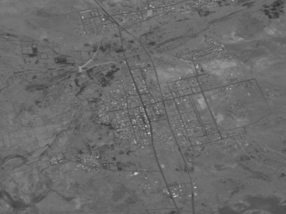
Image Processing
Image Decimation
Input (left) and output (right) example of a decimated image with a decimation factor of 2.

